Slide 1
Web Scraping Data Pipeline Project
Weather Web Scraper

Slide 2
Why I wanted to scrape the weather
Weather data predictions at the moment aren’t great (very challenging)
Finding new ways of analysing this data.
The data is useful for trying different ML models.

Slide 3
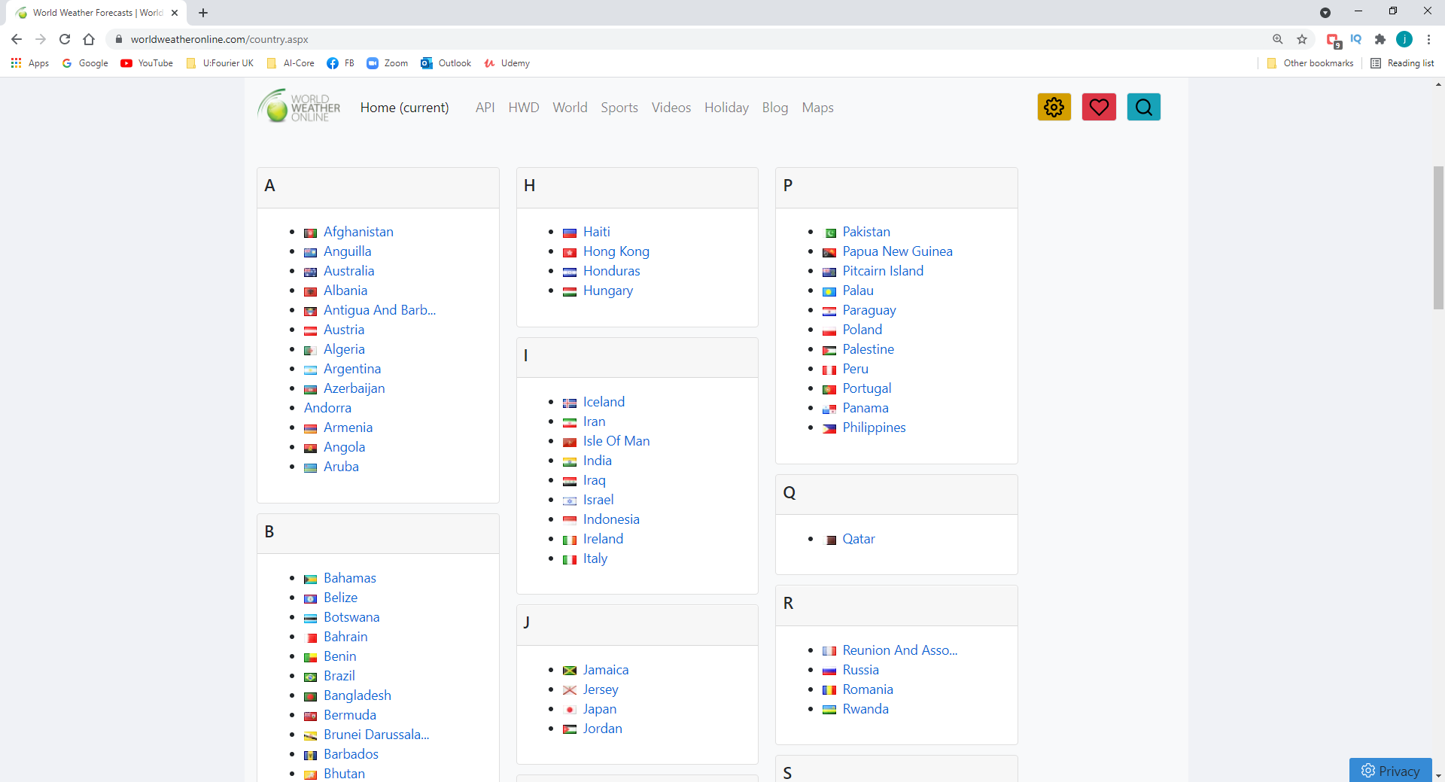

Slide 6
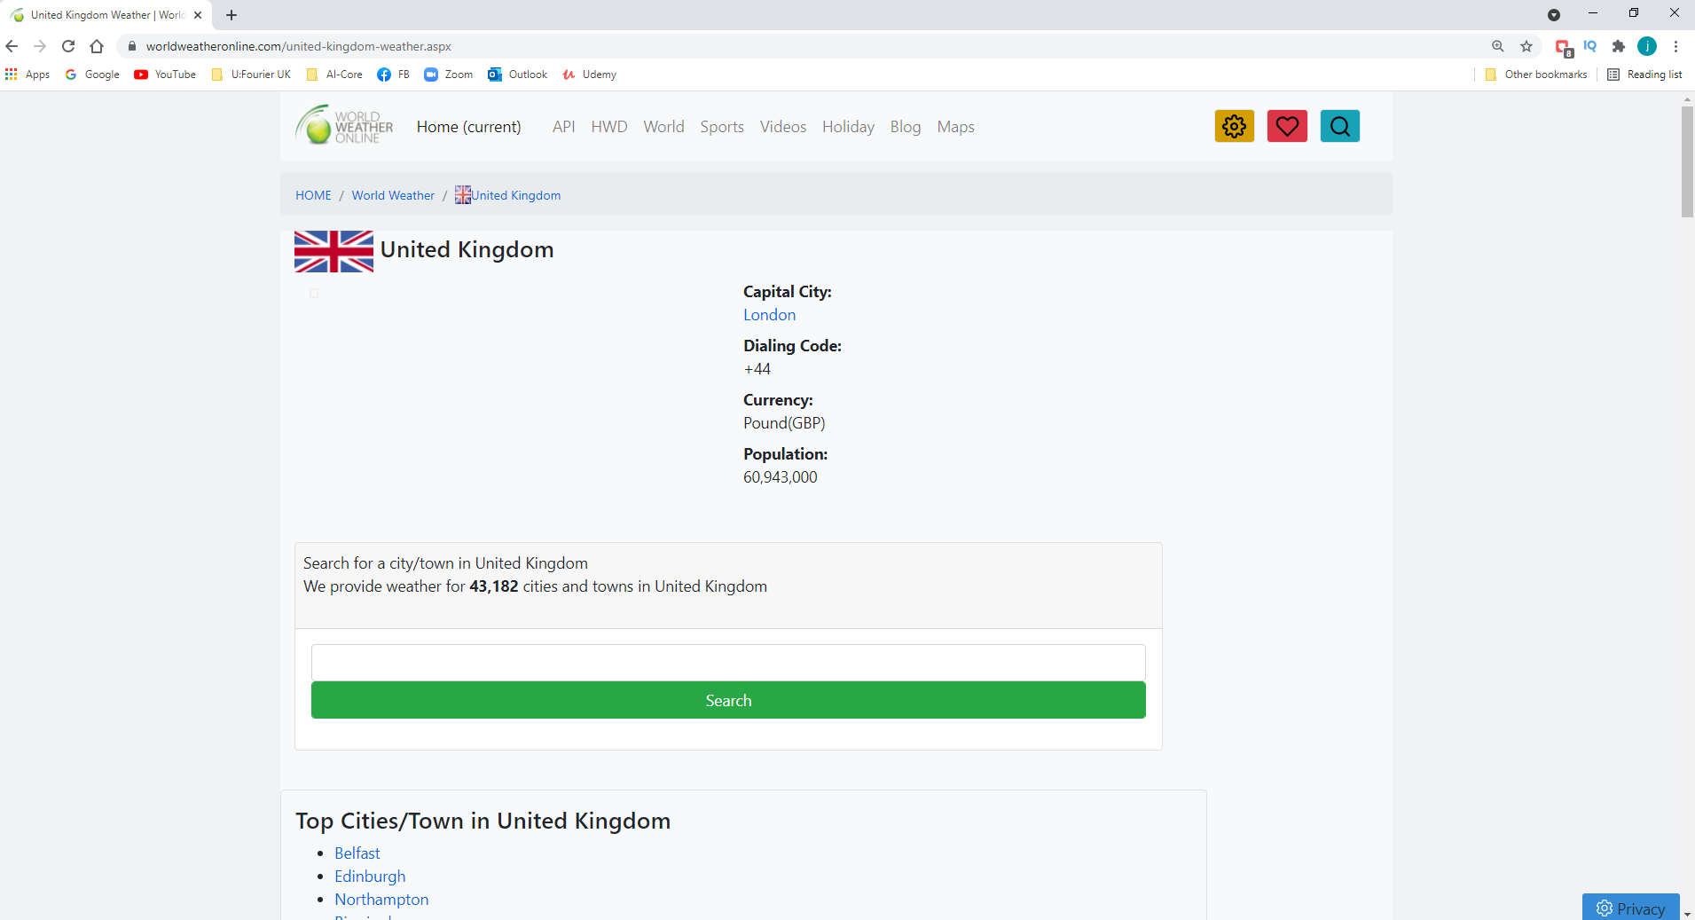

Slide 7
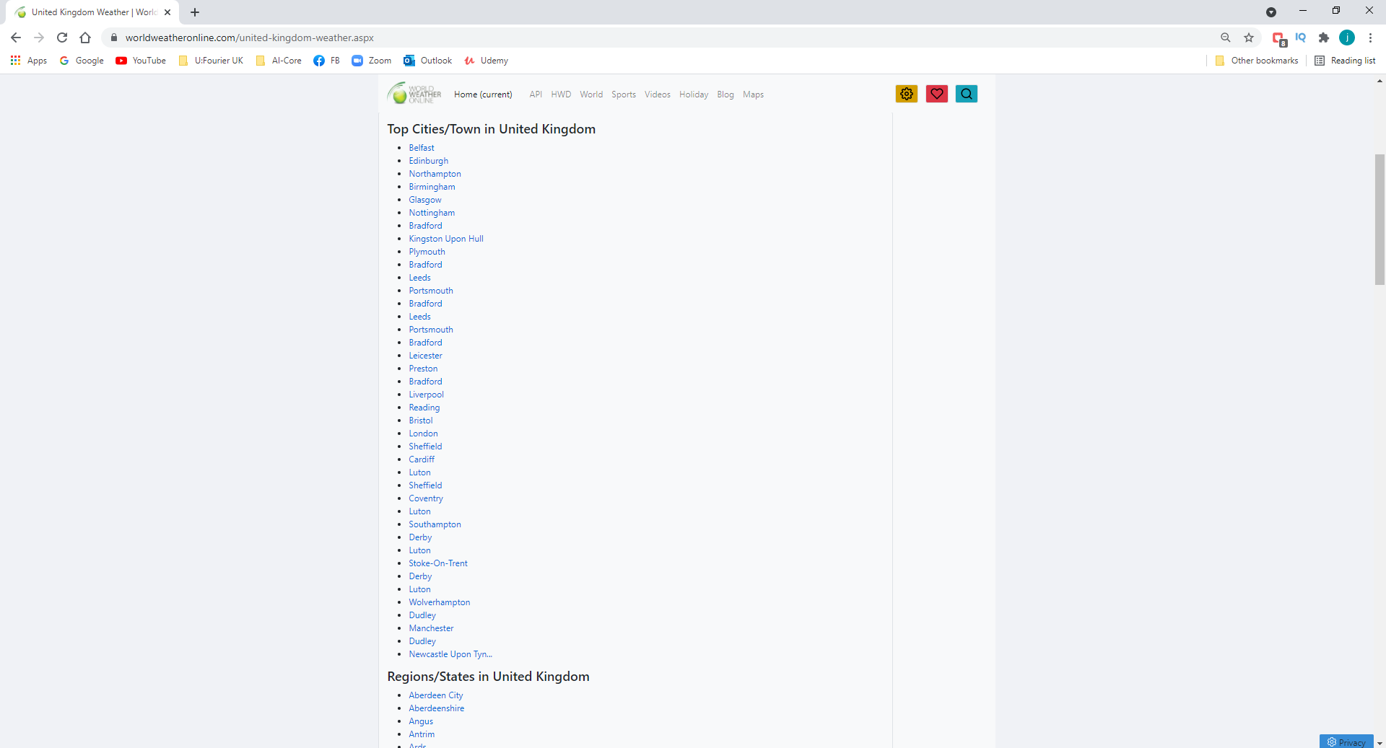

Slide 8
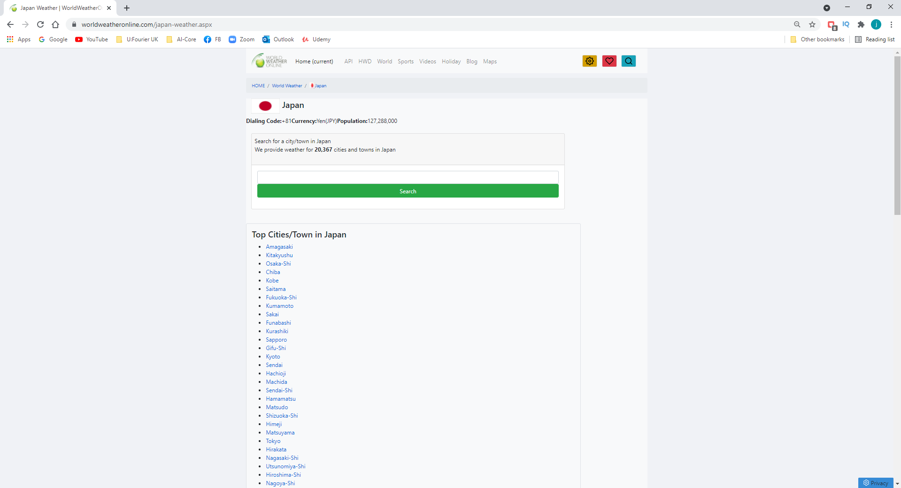

Slide 9
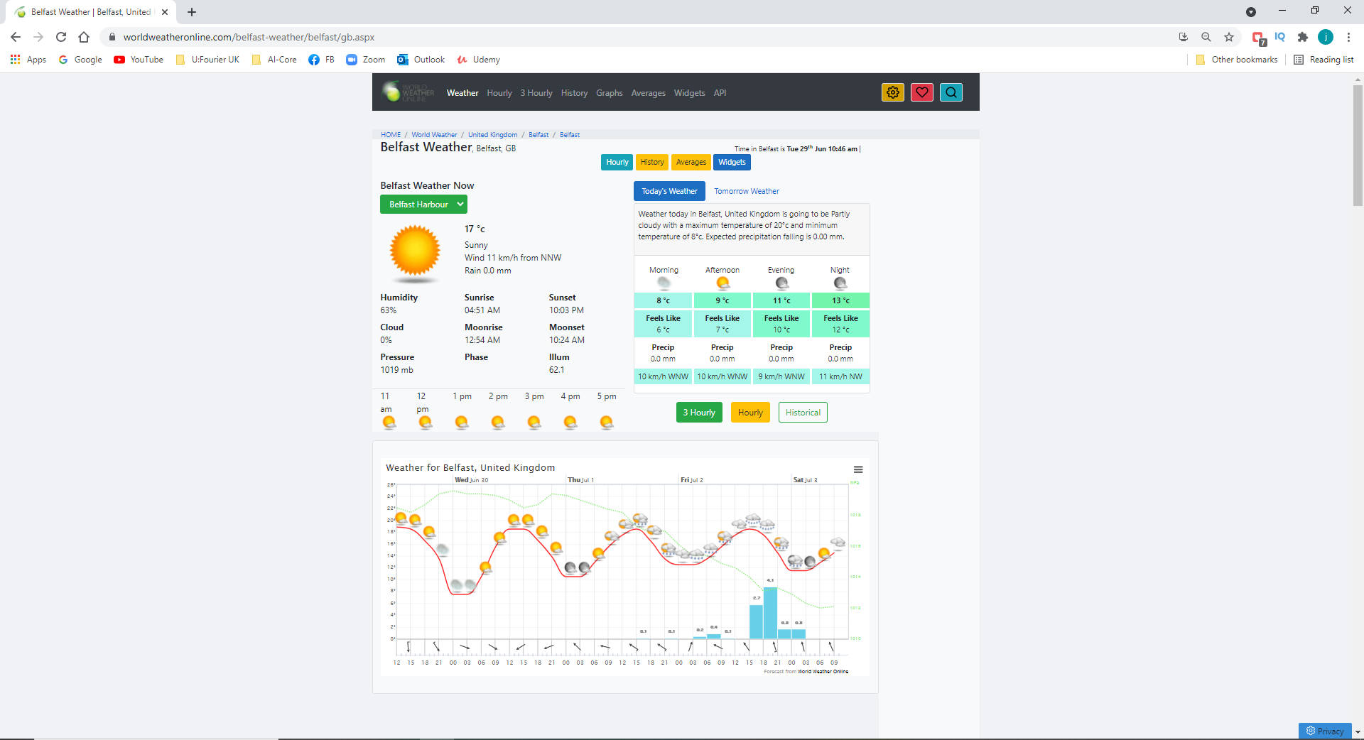

Slide 10
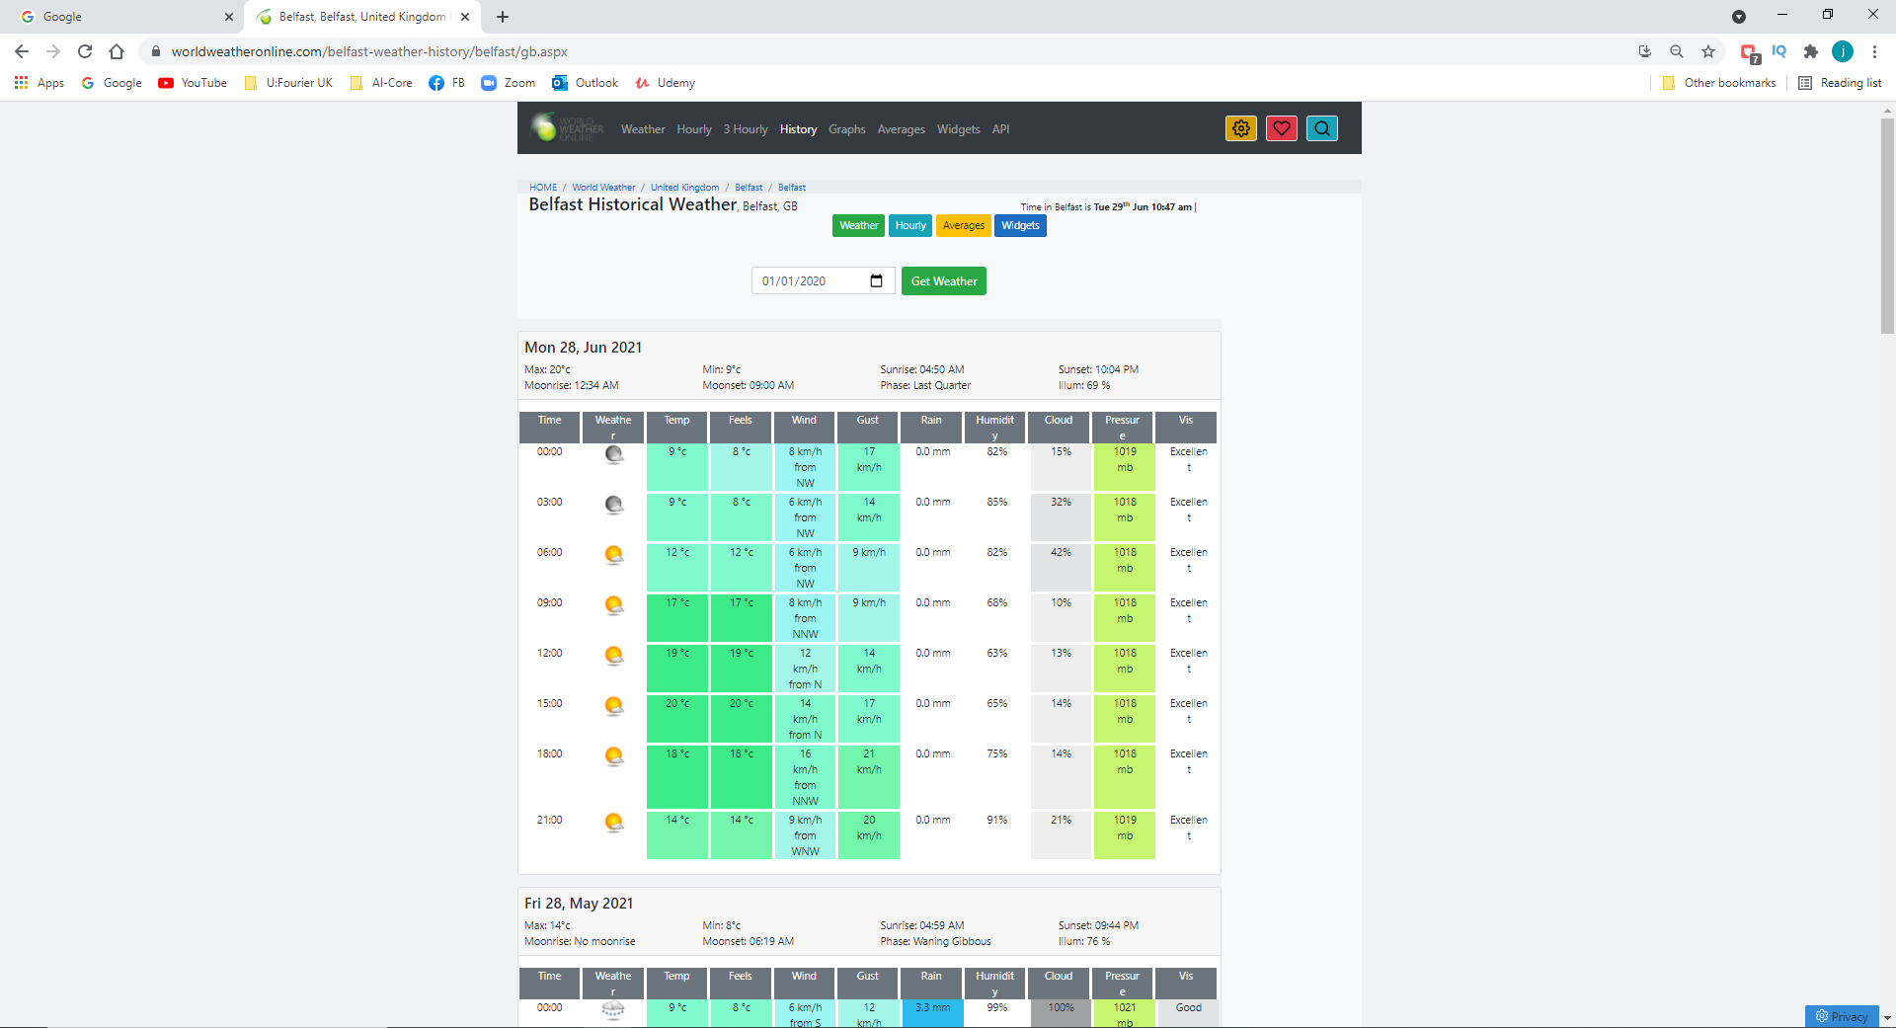

Slide 11
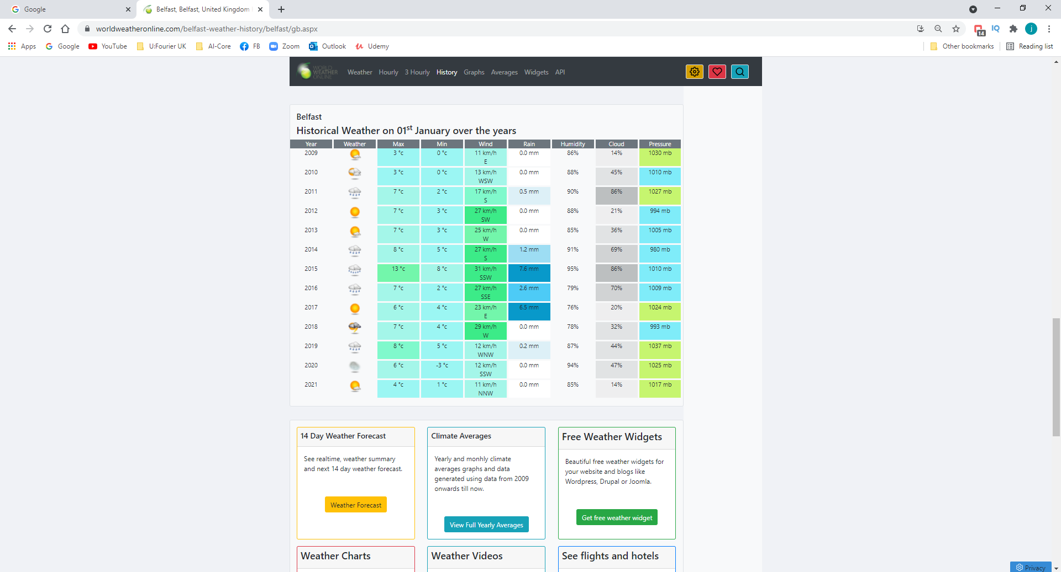
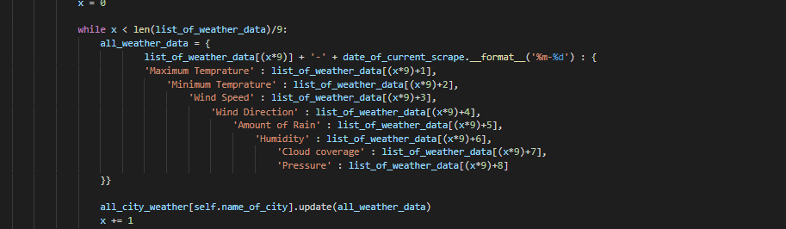
0
9

Slide 12
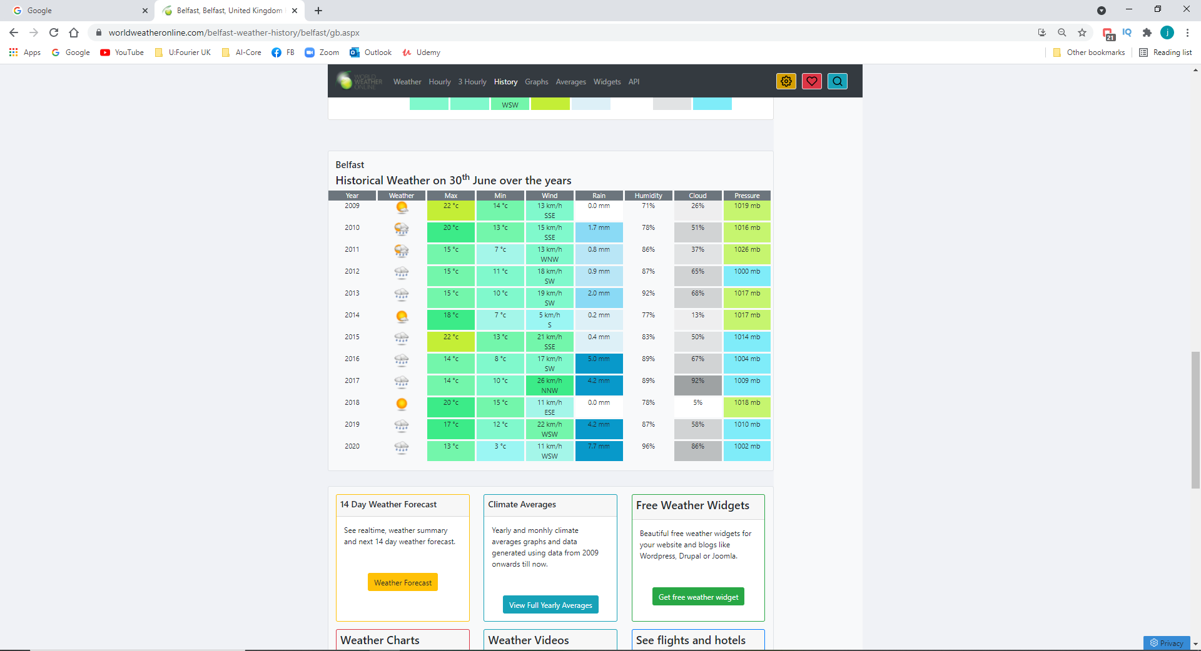

Slide 13
Interesting error!

Slide 14
Interesting error!

Slide 15
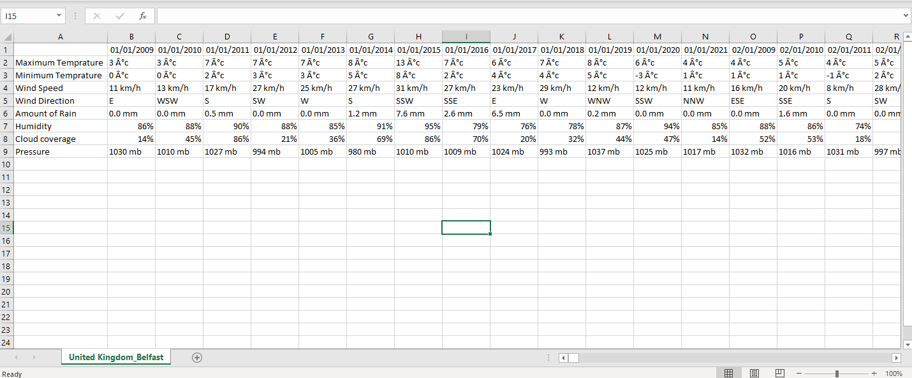
Cleaning the data

Slide 16
